Slide 1


Developing Web Content & Design Plans
Front End Design & Development

Slide 2

Technical vs. Design
The focus of Certificate IV so far …
understanding of the web & wider protocols – HTTP & FTP
technical programming skills – HTML, CSS, JS & PHP
working with web standards & good practices – W3C & WCAG
What about design skills?
Specific tooling has been taught in Emerging Tech
But what is the process for using these tools to plan a website?
But how should we use CSS to design modern web pages?

Slide 3
Planning & Design Focus
Technical expertise is important as a base
You cannot code without having a bit of experience with underlying languages & tooling
But – we should learn the wider approach to web projects
The “Before” Stages of a Web Project
WHAT technology/technologies should we use for certain projects?
WHICH technologies should we pair together to reach an acceptable project solution?
WHO is our intended audience & what does the website need to retain them?
HOW are we to implement the technologies in a manner that achieves the best possible website outcome, with both structural and design aspects in mind?

Slide 4
Planning is Important!
Developing a consistent approach to web projects has its’ benefits:
Consistent web projects & timeframes
Dev can consider all potential users & contemplate all client needs
Makes the web build phase more efficient & coherent
Prior due diligence can uncover issues early
Early problem-solving can reduce unnecessary scope
Dev understands the build’s “MoSCoW”: Must haves - Should Haves - Could Haves - Wont Haves

Slide 5
Planning Really Helps Juniors
Learning code is hard!
Hardest part – having the mental model to solve “what do I do next”
This can lead to a feeling of “being lost”
Clear framework & approach ->
Can improve early confidence in abilities & decision-making
Can reduce the number of errors & poor code
Can speed up how fast you generate web projects
Improves the final product you develop!

Slide 6


Key planning steps
A. WEBSITE STRAGTY PHASE
Website strategy
Content strategy
Information Architecture
B. DESIGN PLANNING PHASE
Wireframes
Style guide
Prototyping
Sign Off & Commence Build

Slide 7
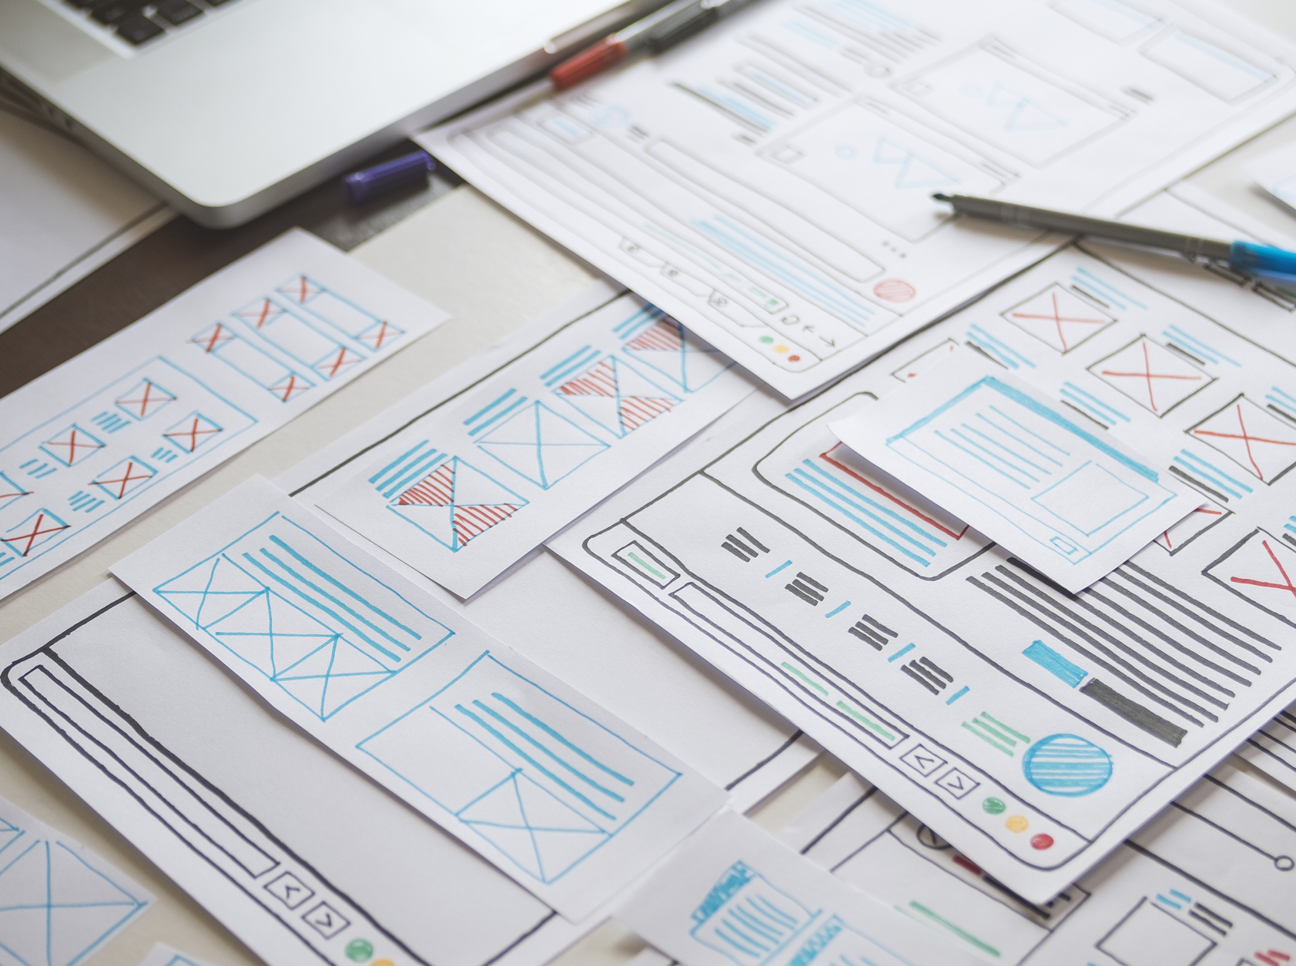
Web approaches are often fluid
Presented Approach is ONE way to plan a web project
Other devs can have different approaches
Some focus more on content & outsource the design stage to graphic designers
Some skip steps and focus straight to wireframing & prototyping
You should be flexible & adjust based on your project timeframe

Slide 8


A Website Strategy Phase

Slide 9
1. Website Strategy
Analysis of client/personal web application & summarising:
Goals of the website
Goals of intended audience / users
Defining what is “success” / “the outcome”
In industry/freelancing, this stage can even include processes such as:
Direct client consultation & presentations
Market research & competitor analysis
User research

Slide 10
2. Content Strategy
Equipped with client raw data, ideation must begin, whereby the design team must generate ideas & possible solutions to eventually generate a viable website prototype
At this stage, we should brainstorm & determine:
What pages to be included on the site
What it should “feel” like on the page
Any important/significant features to be included on a page, or the site in general
In industry/freelancing, this stage can even include processes such as:
“User cases”: this process simulates different users and how they will behave on the planned site to accomplish a goal or task

Slide 11
3. Information Architecture
From here, we need collate all our strategic & content information and organise them in a logical way and establish consistent navigation
At this stage, designers categorise content and create the site map to visualize the content flow and allow the beginnings of the site to take shape

Slide 12
B Design Planning Phase

Slide 13
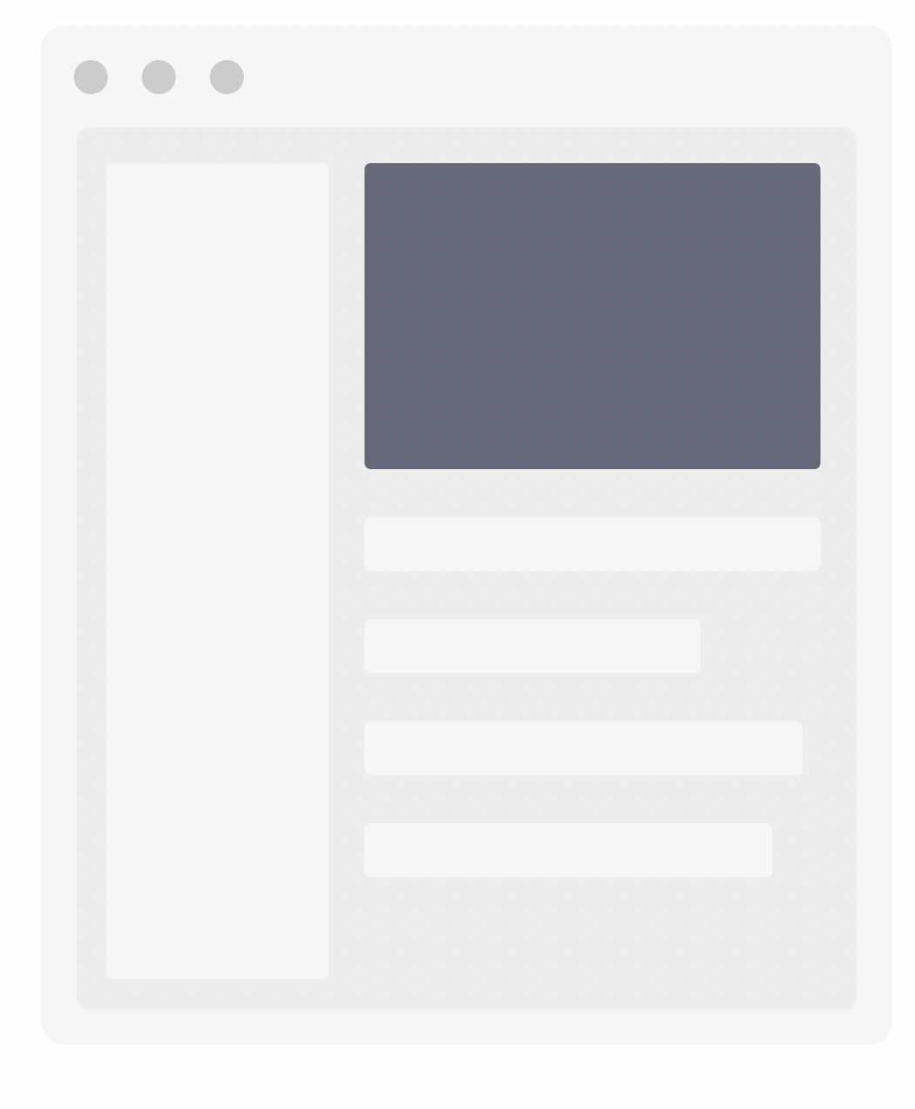
4. Wireframe
The next step is to boil down the pages illustrated in the site map, into a specific Wireframe
The Wireframe will outline the layout of elements on pages, the components needed & necessary features like buttons, images & text
Generally, ONLY in a black & white plan (colour, assets, etc. can be introduced later in prototyping)

Slide 14
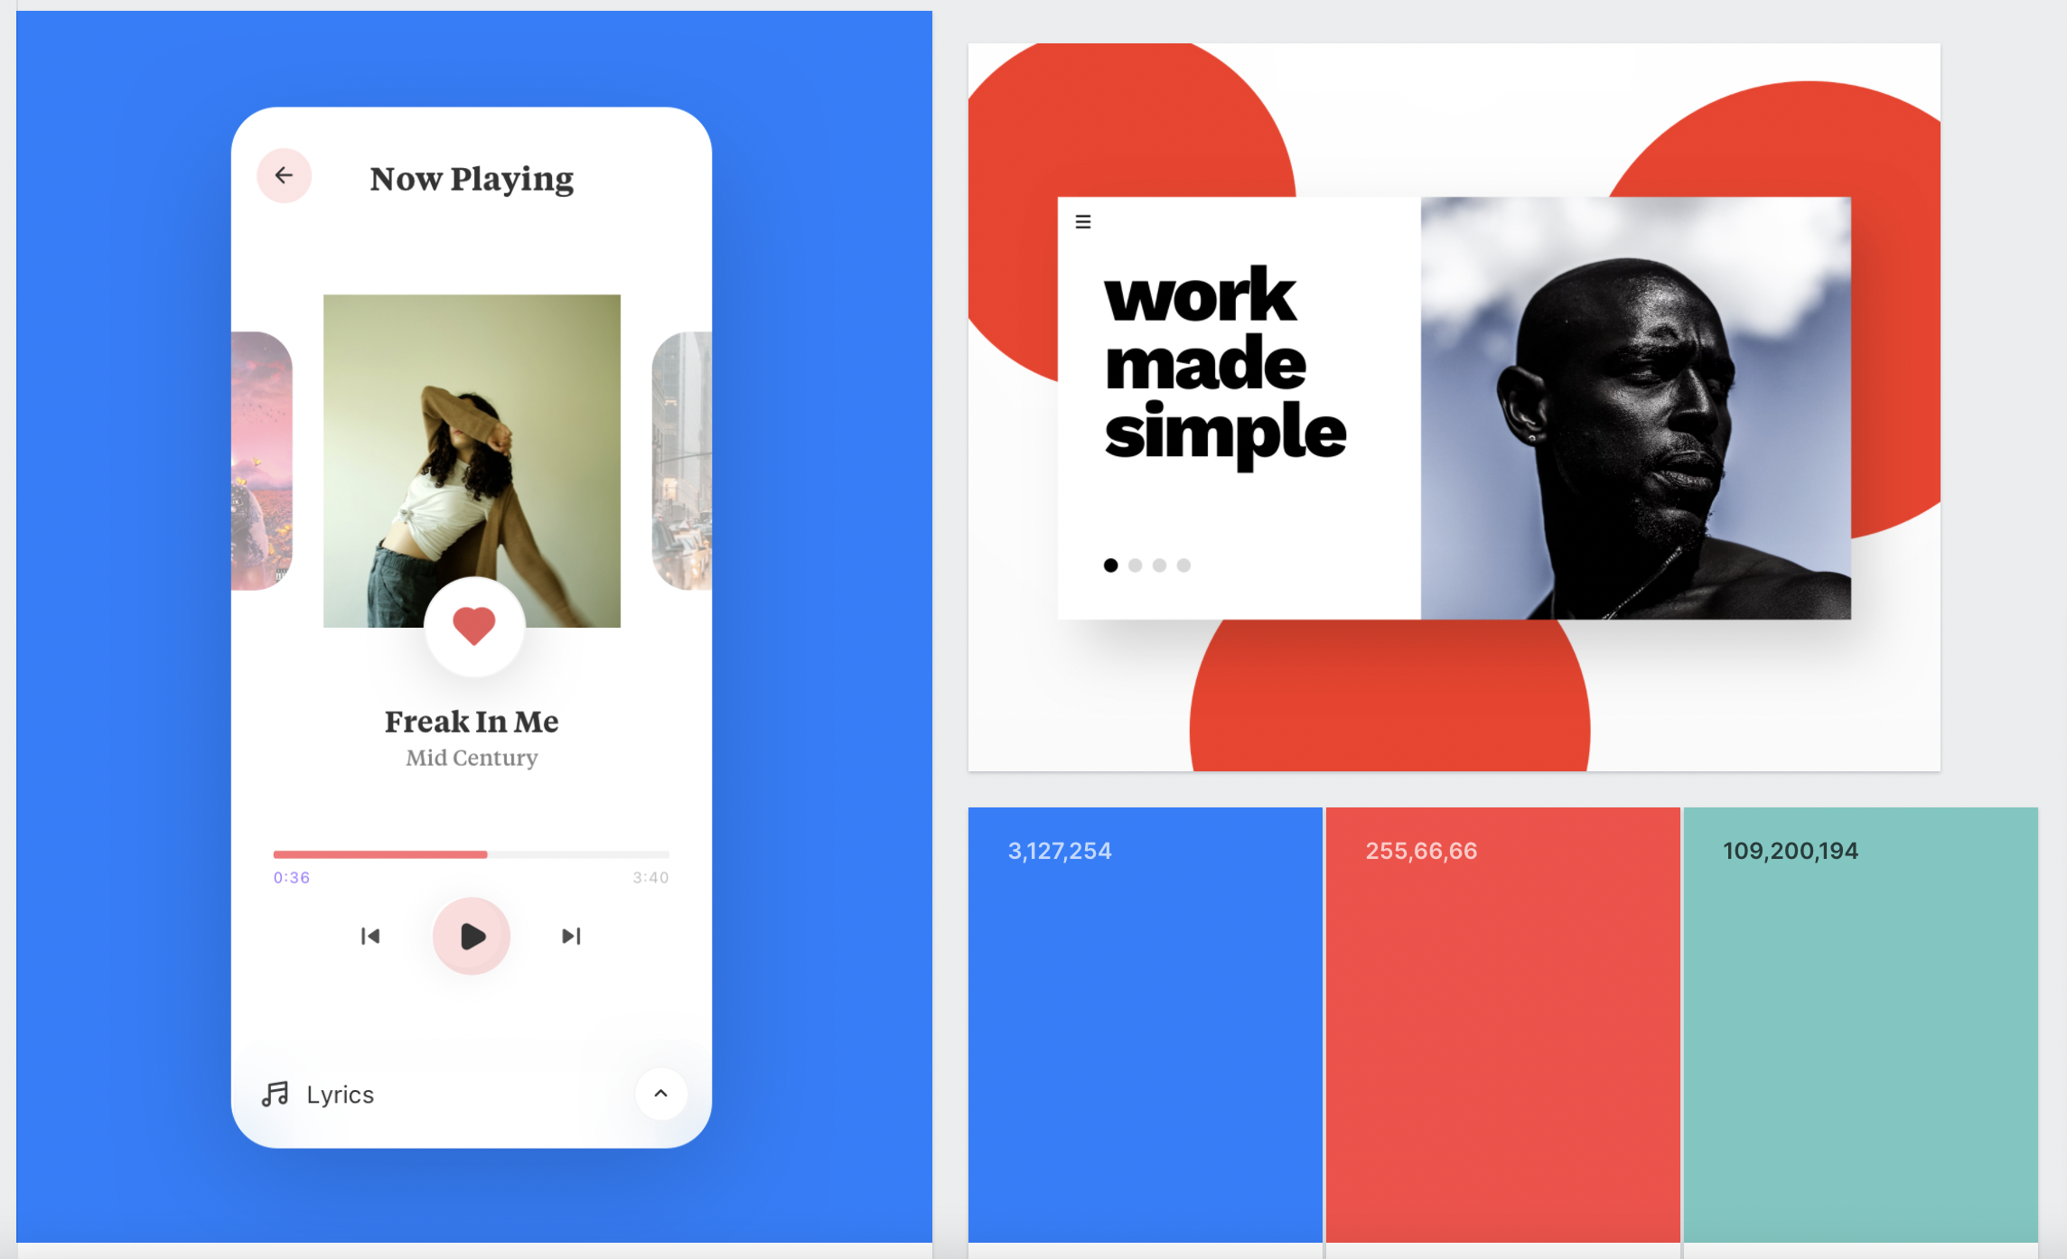
5. Style Guide
Focus now shifts to the appearance and style of the web application – where the necessary components of user interface design are determined
This aids setting out a common style, colour palette, typography, themes, assets and forms to implement in the product
The best tool this is captured within is often the UI Mood Board

Slide 15
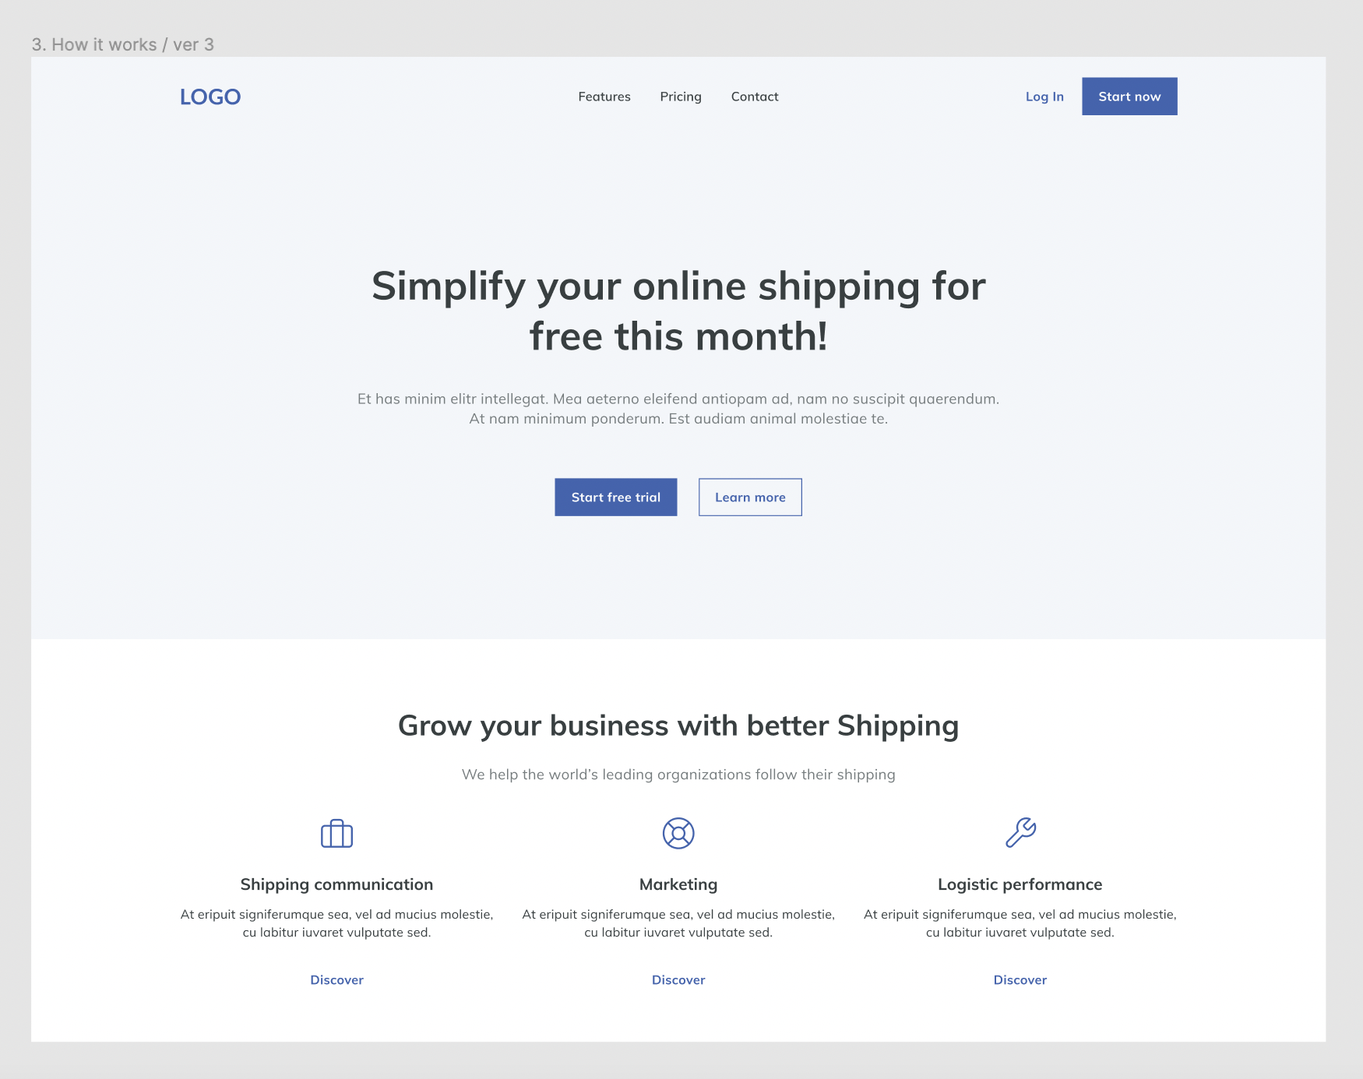
6. Prototyping
With all the design components assembled (generally stored in a “UI Guidebook”) & general layout of the website’s architecture established, the stages are combined into a paper OR digital prototype of the website
Effectively, the prototype should encapsulate the structure of the wireframes, overlaid with the UI design components (“effectively coloured & filled-in wireframes”)

Slide 16

7. Sign Off & Commence Build

Slide 17
Review of Design Tools

Slide 18


A. Website Strategy Phase

Slide 19


B1. Wireframe Stage

Slide 20

B2. Style Guide Stage

Slide 21

B3. Prototyping Stage

Slide 22

Planning & Your Portfolio Assessment

Slide 23
A2 Emphasis on Planning
Students will need to complete the following to a competent BUT NOT commercial degree:
Review of website & content strategy (Part 1)
User analysis to determine UI (Part 1 & 2)
Generation of a basic site map (Part 2)
Generation of THREE wireframes for website (Part 2)
No moodboard or prototype required (time restraints)

Slide 24
End of Today’s Class
Conduct the initial planning stages for your portfolio:
Determine the design tools (e.g. Figma) and web technologies that you plan to use
Brainstorm the strategic objectives and intended users of the website
Brainstorm the needed content & UI required for the website
Develop the sitemap, by condensing objectives & content brainstorm maps
Develop your wireframes for your three main pages
(If time) Feel free to develop a basic mood board to determine font family & colour mix (primary, complementary & branding)

